Slide 1

The Foundation of
Leadership
Josiah B. Andor, PhD

Slide 2

Focus of Presentation
The concept of leadership from the Biblical Perspective
Notes:
This lecture assesses the theology of leadership from the Biblical Perspective. The lecture traces leadership from the very beginning (ie, creation) and how it has generally been in scripture. God gave the mandate of leadership to Adam (Genesis 1:28) and this has continued through the centuries. All through the Old Testament, God has bestowed the mandate of leadership to humans (Patriarchs, Prophets, Priests, Kings, etc). Jesus left an example of Christian leadership and established leadership when he established the church. The lessons from scripture present an excellent model for church leadership.

Slide 3
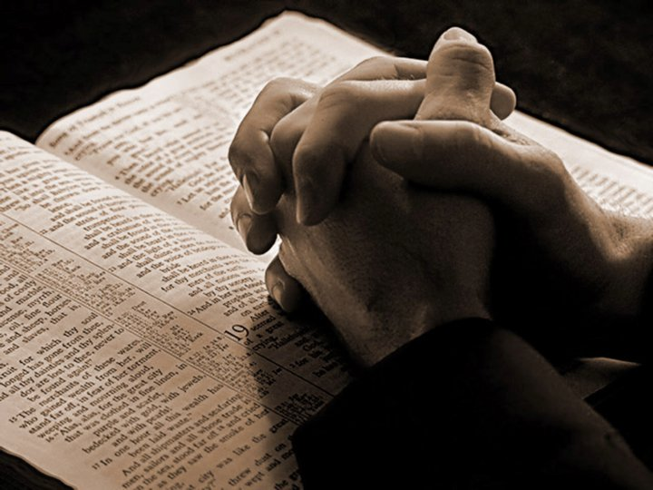
John 21:17

Slide 4

John 21:17
¹⁷ He said to him the third time, "Simon, son of Jonah, do you love Me?" Peter was grieved because He said to him the third time, "Do you love Me?" And he said to Him, "Lord, You know all things; You know that I love You." Jesus said to him, "Feed My sheep.
Notes:
John 21:17 ¹⁷ He said to him the third time, "Simon, son of Jonah, do you love Me?" Peter was grieved because He said to him the third time, "Do you love Me?" And he said to Him, "Lord, You know all things; You know that I love You." Jesus said to him, "Feed My sheep.

Slide 5

What is
LEADERSHIP
?

Slide 6
LEADERSHIP
"a process of social influence in which one person can enlist the aid and support of others in the accomplishment of a common task"
“the action of leading a group of people or an organization, or the ability to do this”
"organizing a group of people to achieve a common goal"

Slide 7


Slide 8


Slide 9


Slide 10


Slide 11


Slide 13

A LEADER
“somebody whom people follow.”

Slide 14
A LEADER
“somebody who guides or directs others”

Slide 15
A LEADER
“Somebody with Influence”

Slide 16


Leadership has influence
A leader is anyone who can influence another person or group to do something, good or bad

Slide 17

A common Goal

Slide 18
Matthew 28:19-20
¹⁹ "Go therefore and make disciples of all the nations, baptizing them in the name of the Father and of the Son and of the Holy Spirit, ²⁰ "teaching them to observe all things that I have commanded you; and lo, I am with you always, even to the end of the age." Amen.
Notes:
Matthew 28:19-20 ¹⁹ "Go therefore and make disciples of all the nations, baptizing them in the name of the Father and of the Son and of the Holy Spirit, ²⁰ "teaching them to observe all things that I have commanded you; and lo, I am with you always, even to the end of the age." Amen.

Slide 19

Sacred Responsibility
Choosing quality officers is important for the prosperity of the church, which should exercise the greatest care when calling men and women into positions of sacred responsibility.

Slide 20
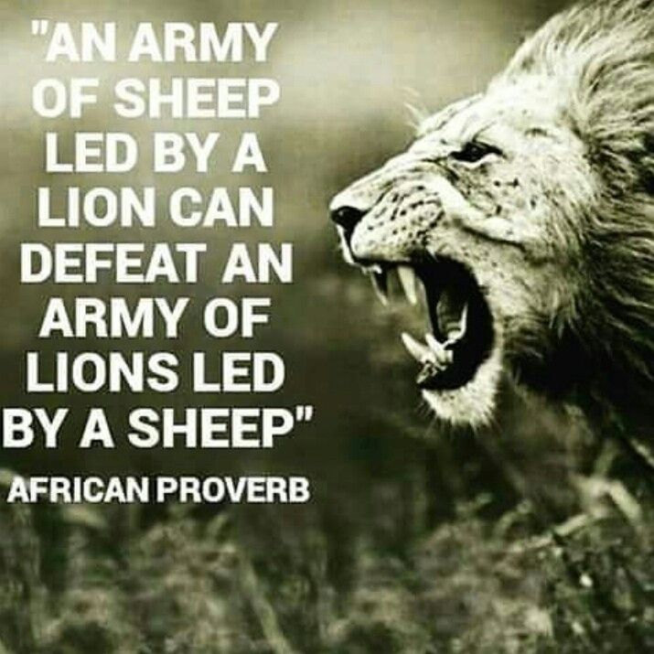

Slide 21

The Genesis of Leadership
Genesis 1:28: Then God blessed them, and God said to them, "Be fruitful and multiply; fill the earth and subdue it; have dominion over the fish of the sea, over the birds of the air, and over every living thing that moves on the earth."

Slide 22
The Core Point!
From the foregoing, we can say that leadership is the management of heavenly resources, including people, talent , and time.
Leadership is commissioned by God and should be treated as such

Slide 23
Christian LEADERSHIP
Christian leadership is the process by which men and women called by God give servant direction and humble guidance to a body of believers toward a common goal using biblical principles.

Slide 24
Leadership through the OT
Patriarchs
Moses
Priests
Judges
Samuel
Kings
Prophets

Slide 25
New testament
Priests
Rabbis
Pharisees
Sadducees

Slide 26
Church
LEADERSHIP

Slide 27
NT Church Leadership
He said to him the third time, "Simon, son of Jonah, do you love Me?" Peter was grieved because He said to him the third time, "Do you love Me?" And he said to Him, "Lord, You know all things; You know that I love You." Jesus said to him, "Feed My sheep. (John 21:18)

Slide 28
Qualifications
Church Leaders must have a godly character , etc (1 Timothy 3).
Since biblical leadership requires submissive followers, the leader is placed in a position over a vulnerable, submissive staff. Therefore, the Integrity of the important.
A leader must be truthful, honest, and faithful (Exodus 18:21) to warrant submission from followers and to protect them from abuse
Spirit-Filled (Acts 6:I3)
Able to teach (2 Tim. 2:2).

Slide 29

Spiritual Leadership
Skill and experience are both important traits and should not be minimized.
However, being spirit-filled and spirit-led are the most essential and important qualities

Slide 30
Spiritual Leadership
The goal is to feed the flock so they can fulfill the mission given by Christ to the Church – Taking the gospel out and getting all into Salvation

Slide 31
Church Leadership
Church leadership is a call to Spirituality
A spiritual leader is a person of prayer
A spiritual leader must be a person of “vital piety”
A spiritual leader must lead with love
Notes:
Spirituality is a pre-requisite to church leadership

Slide 32
Church Leadership
Church leadership is a call to Spirituality
A spiritual leader is a person of prayer
A spiritual leader must be a person of “vital piety”
A spiritual leader must lead with love
Notes:
Make a prayer list

Slide 33
Church Leadership
Church leadership is a call to Spirituality
A spiritual leader is a person of prayer
A spiritual leader must be a person of “vital piety”
A spiritual leader must lead with love
Notes:
Reflect the character of Christ

Slide 34
Church Leadership
Church leadership is a call to Spirituality
A spiritual leader is a person of prayer
A spiritual leader must be a person of “vital piety”
A spiritual leader must lead with love
Notes:
Love must be a hallmark

Slide 35
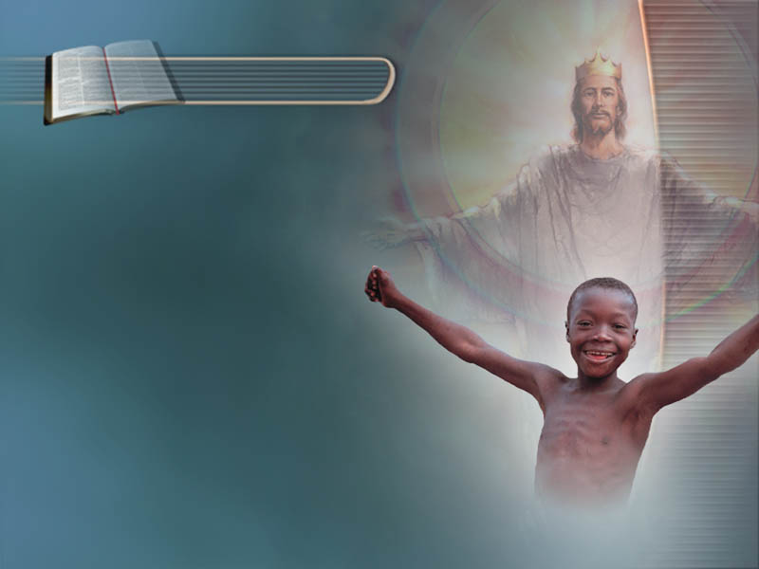
Be the best that you can be
Notes:
The motive of Nehemiah's enemies was to show the Jews that their leader had no real concern about the Law, but was rebuilding the walls for personal reasons (v. 13). This incident was only one of several in which false prophets tried to deceive Nehemiah (v. 14). Satan still employs these three strategies as he seeks to destroy the effectiveness of spiritual leaders. One writer called them intrigue, innuendo, and intimidation.

Slide 36

idealness
Have the Mind of a Leader

Slide 37
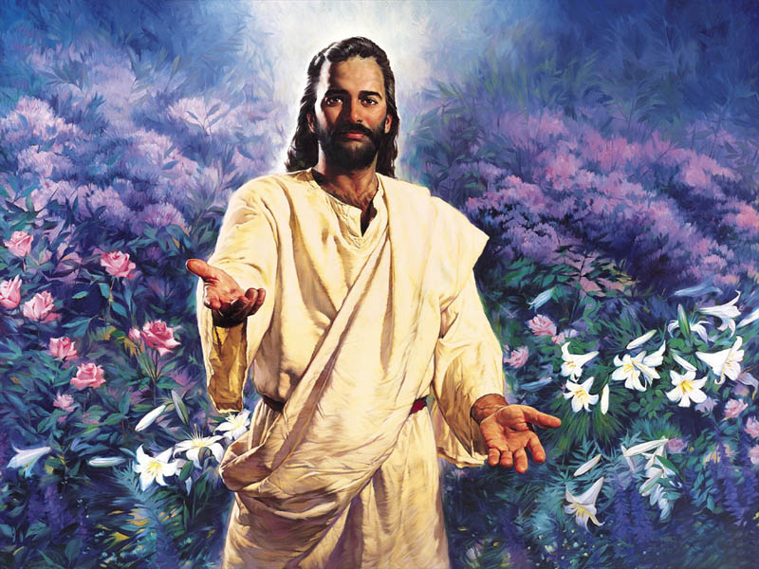
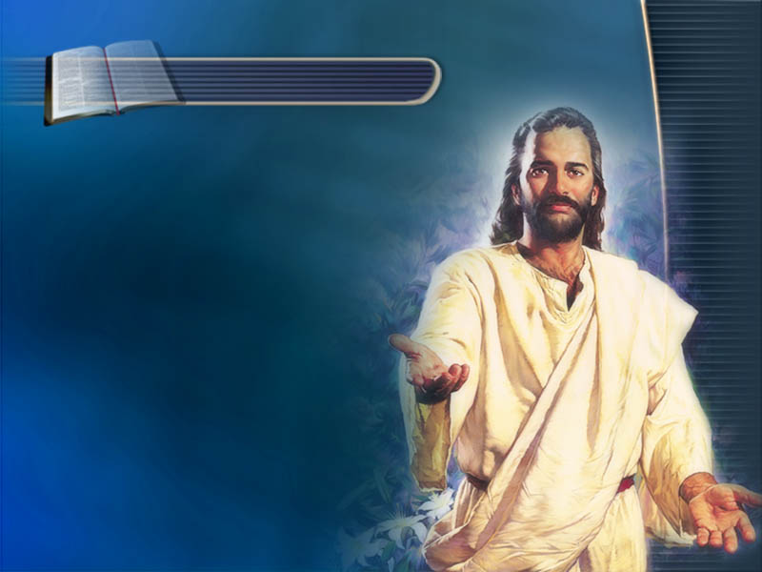
To be called to be a Church leader is a called to
“Feed my Sheep”

Slide 38

Question Time

